Slide 1
Segmentation
Cherry Khosla

Slide 2
What is segmentation?
Segmentation is a non-contiguous memory management technique in which the program is divided in to variable size parts called as segments.
Segmentation supports user’s view of memory.
A segment is a logical unit such as main program, procedure, function, stacks, heaps, common blocks, symbol table, arrays etc.
The logical address space is a collection of segments. Each segment has a
  Name
  Length
Cherry Khosla

Slide 3
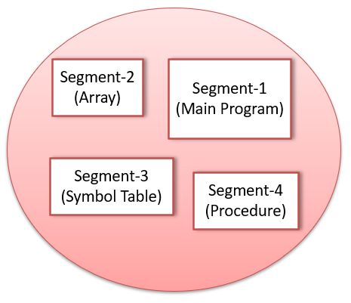
Address space in segmentation
The address specifies both segment name and the offset within the segment.
Thus, a logical address consists of two tuples
  <segment-number, offset>
User’s view of memory
Cherry Khosla

Slide 4
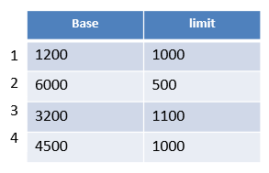

Hardware support
This two-tuple address is mapped to physical address with the help of a table called as segment table.
Each entry in the segment table has a
  segment base
  segment limit
  where segment base contains the starting physical address where the segment resides in memory, whereas the segment limit specifies the length of the segment.
Cherry Khosla

Slide 5
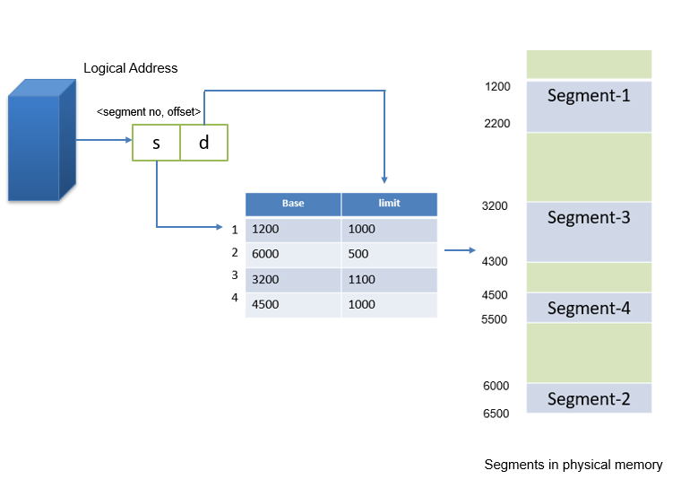
Hardware support
Mapping of logical address to physical address
Cherry Khosla

Slide 6
Paging v/s Segmentation
Basis for comparison | Paging | Segmentation
Partition | Fixed Size Partitioning | Variable Size Partitioning
View | Supports system’s view of memory | Supports user’s view of memory
Address | The address generated by CPU is divided into page number and offset | The address generated by CPU is divided into segment number and offset
Size of partition | The system decides the size of page | The size of segment is decided by the user
Fragmentation | Paging may lead to internal fragmentation | Segmentation may lead to external fragmentation
Cherry Khosla

